Slide 1
Belle - II Data Analysis : Classifying Particle Events
A Machine learning approach with PCA and logistic regression
Presented by - Aniket, Chirag, Hamza, Rahul

Slide 2
Objective: To analyze the Belle-II dataset and build a binary classification model to distinguish between two categories of particle events.
Data Set:
Source: Belle -II Data set
Key steps:
Data exploration and visualization
Target transforming , Scaling, PCA
Model training (Logistic regression)
Model Evaluation

Slide 3
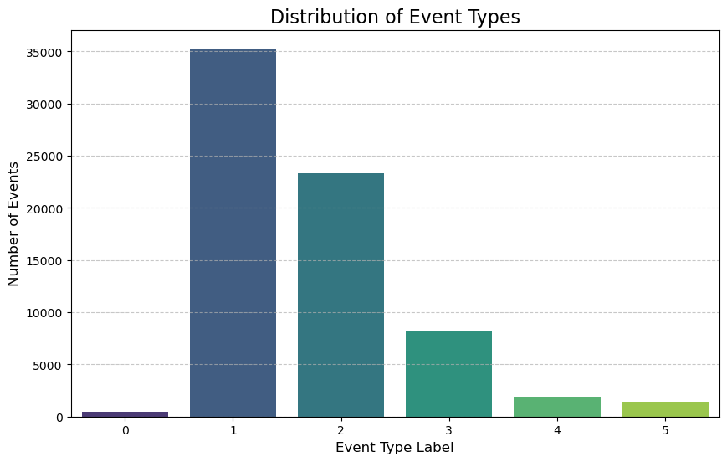
Initial data exploration
Dataset contains 70606 events and
61 columns.

Slide 4
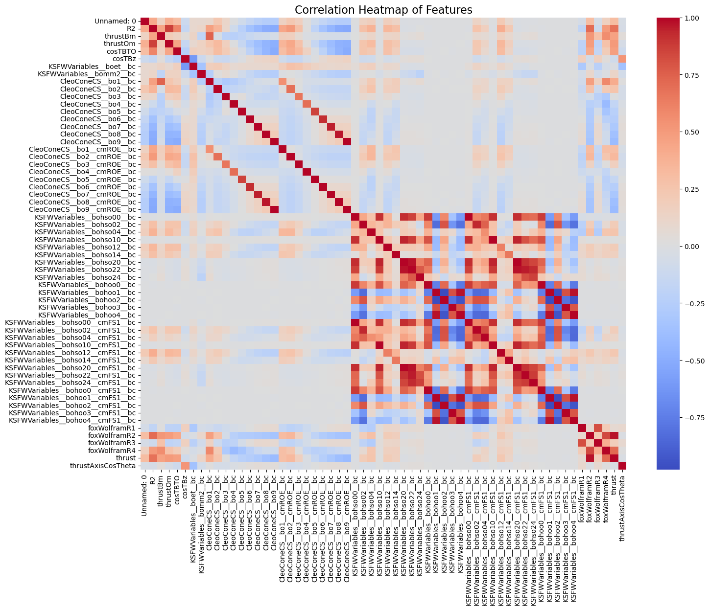
Correlation matrix
Found 60 numeric features.
Top 10 correlated feature pairs:
KSFWVariables__bohso10__bc KSFWVariables__bohso10__cmFS1__bc 1.000000
KSFWVariables__bohoo4__bc KSFWVariables__bohoo4__cmFS1__bc 1.000000
KSFWVariables__bohoo2__bc KSFWVariables__bohoo2__cmFS1__bc 1.000000
KSFWVariables__bohoo1__bc KSFWVariables__bohoo1__cmFS1__bc 1.000000
KSFWVariables__bohoo3__bc KSFWVariables__bohoo3__cmFS1__bc 1.000000
KSFWVariables__bohoo0__bc KSFWVariables__bohoo0__cmFS1__bc 1.000000
KSFWVariables__bohso00__bc KSFWVariables__bohso00__cmFS1__bc 1.000000
KSFWVariables__bohso20__bc KSFWVariables__bohso20__cmFS1__bc 1.000000
CleoConeCS__bo9__bc CleoConeCS__bo9__cmROE__bc 0.995908
KSFWVariables__bohso20__bc KSFWVariables__bohso22__bc 0.973954

Slide 5
Performing PCA
Original event counts: New binary event counts (Class 0: [0,1], Class 1: [2,3,4,5]):
Type
0 | 4462
1 | 35303
2 | 23333
3 | 8172
4 | 1879
5 | 1457
0 | 35765
1 | 34841
Original training data shape: (56484, 59)
PCA-transformed training data shape: (56484, 23)
PCA selected 23 components to explain 95% of variance.

Slide 6
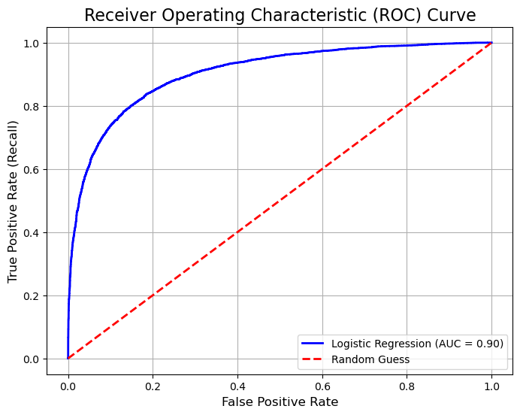
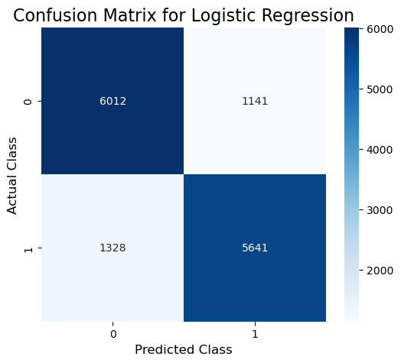
Model Accuracy

Slide 7
Model Accuracy
Accuracy on the test set: 0.8252
Area Under ROC Curve (AUC): 0.9042
Classification Report:
precision recall f1-score support
0 0.82 0.84 0.83 7153
1 0.83 0.81 0.82 6969

